Slide 1
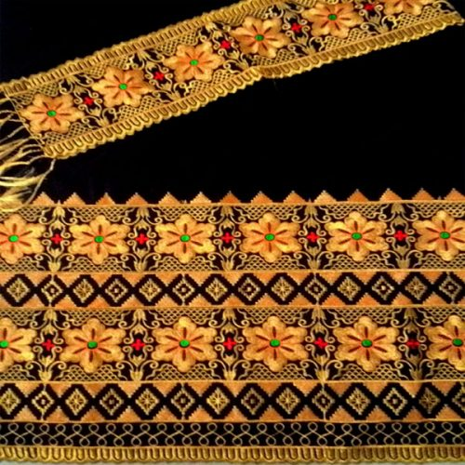
Pertemuan 3
Pengantar Sistem dan Teknologi Informasi

Slide 2
Perangkat Keras Komputer (Hardware)
Komponen Hardware
  Central Processing Unit(CPU)
  Media Penyimpanan atau Memory
  Input Device (Peralatan Input)
  Output Device (Peralatan Output)
  Communication Device (Peralatan Komunikasi)

Slide 3
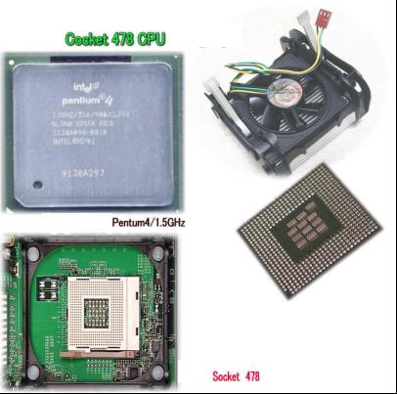
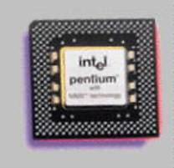
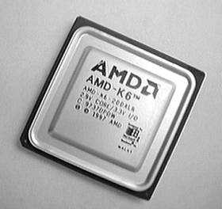
Perangkat Keras Komputer (Hardware) (cont.)
Central Processing Unit (CPU)
  Komponen CPU :
    Control Unit
    Arithmatic Logic Unit (ALU)

Slide 4
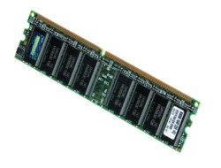
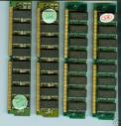
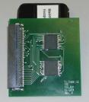

Perangkat Keras Komputer (Hardware) (cont.)
Media Penyimpanan (Storage)
  Primary Storage
    RAM (Random Access Memory)
      DRAM (Dynamic RAM)
      SRAM (Static RAM)
      EDORAM (Extended Data Out RAM )
        72 pin
      SDRAM
      168 pin

Slide 5


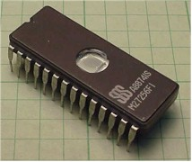
Perangkat Keras Komputer (Hardware) (cont.)
    ROM (Read Only Memory)
      PROM EEPROM
      EPROM

Slide 6

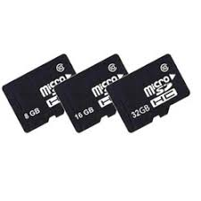
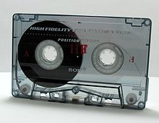
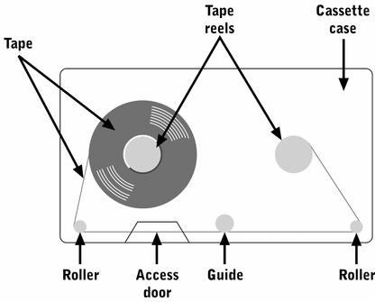
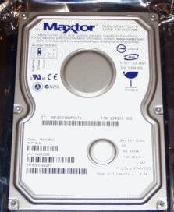
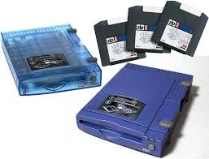
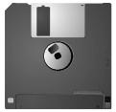
  Secondary Storage (Cont..)
  Magnetic Storage
    Magnetic tape
    Magnetic Disk
    Hard Disk
        Floppy Disk (Diskette) MMC
        Flash Memory Zip Drive

Slide 7
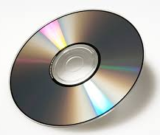
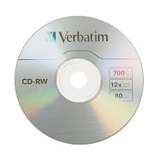
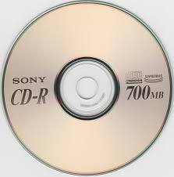

  Secondary Storage (Cont..)
  Optical Storage
    CD
    CD-R
        CD-RW
        DVD

Slide 8
Perangkat Keras Komputer (Hardware) (cont.)
Perbandingan Primary Storage dan Secondary Storage :
  Temporary vs Permanent
  Hanya dapat menyimpan data jika komputer nyala vs Dapat menyimpan data jika komputer mati

Slide 9




Perangkat Keras Komputer (Hardware) (cont.)
Peralatan Input (Input Device)
  Keyboard
  Pointing Device
    Mouse
    Trackball
    Joystick

Slide 10
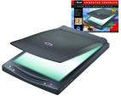


Perangkat Keras Komputer (Hardware) (cont.)
Optical Reading Device (scanner)
  Barcode Reader Image Scanner
  Handprint Reader

Slide 11
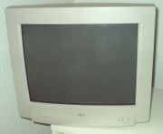
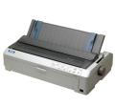
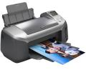
Perangkat Keras Komputer (Hardware) (cont.)
Peralatan Output (Output Device)
  Visual Display (Monitor)
  Printer
    Impact Printer
    : dot matrix printer
    Non Impact Printer
    : inkjet printer

Slide 12



Perangkat Keras Komputer (Hardware) (cont.)
  Plotters
  Computer Output Microfilm (COM)
  Audio Response Unit (ARU)
Voice Output Device dalam bentuk Flash Memory

Slide 13

Perangkat Keras Komputer (Hardware) (cont.)
Peralatan Komunikasi (Communication Device)
  Modem (Modulation Demodulation)
    External vs Internal Modem
    Smart Modem
    Fax modem

Slide 14
End

